Slide 1
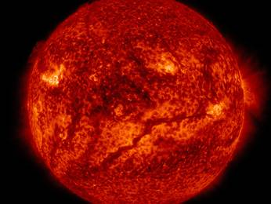

Chapter 4
Insolation and Temperature

Slide 2
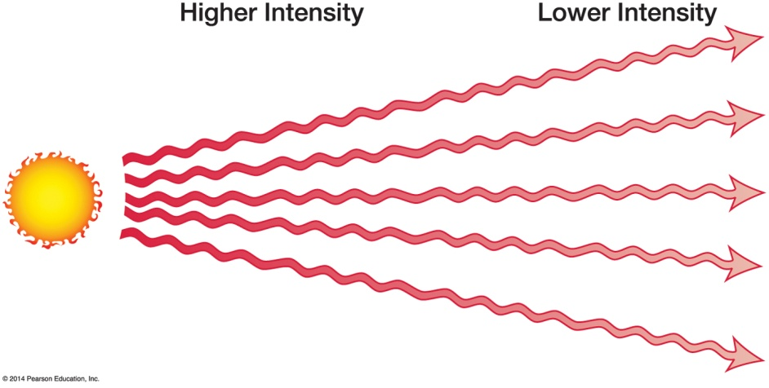
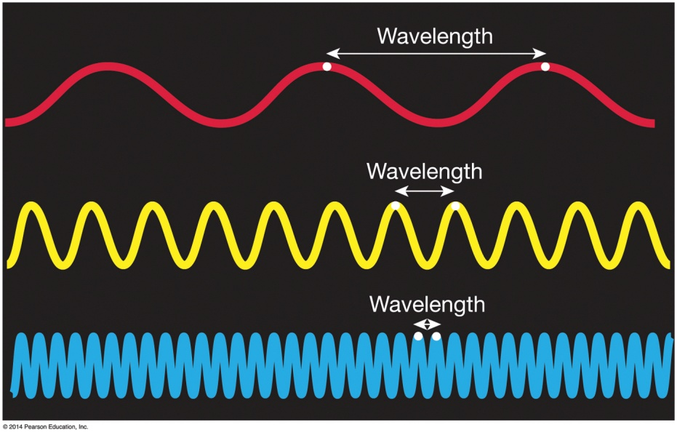
Solar Energy
Solar energy is electromagnetic energy
Electromagnetic spectrum
Wavelengths and frequency
Shortwave solar radiation, insolation

Slide 3
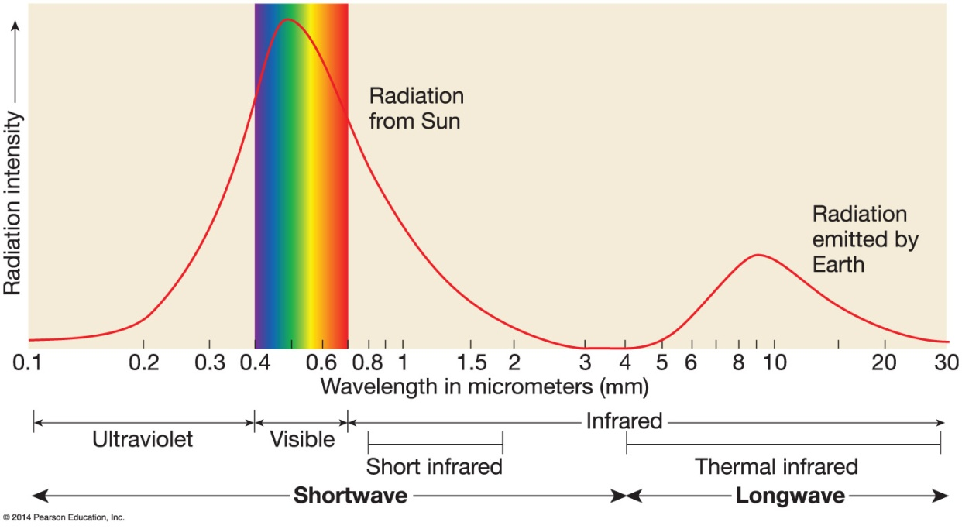
Basic Heating and Cooling Processes in the Atmosphere
Radiation
Definition
Warmer objects radiate more effectively
Warmer objects emit at shorter wavelengths (e.g., the Sun)
Sun ultimate “hot” body in solar system
Notes:
Radiation or emission is the process by which electromagnetic energy is emitted from an object. Refers to the emission and flow of electromagnetic energy. All objects emit electromagnetic energy, but hotter objects are more intense radiators than cooler objects. The hotter the object the more intense radiators than cooler objects.
Radiating efficiency is also important. Objects at the same temperature may vary considerable in their radiating efficiency An object that emits the maximum possible amount of radiation at all wavelengths is called a blackbody radiator. Both the sun and Earth are nearly function as blackbodies. At almost 100% efficiency. The atmosphere does not however.

Slide 4
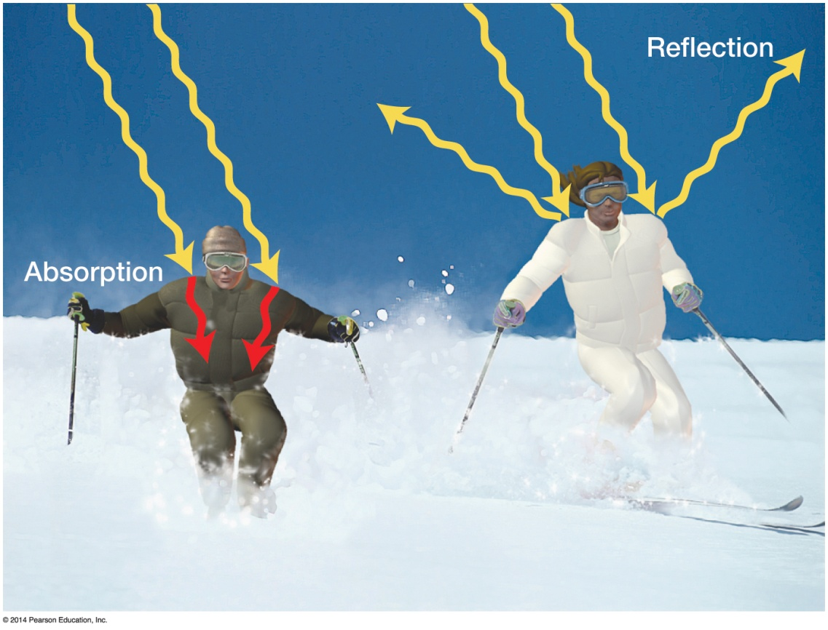
Basic Heating and Cooling Processes in the Atmosphere
Absorption
Body absorbs radiation
Good radiator, good absorber
Reflection
Objects repel electromagnetic waves
Opposite of absorption
Notes:
Absorption- Electromagnetic waves striking an object may be assimilated in the object as absorption. Different materials have different absorptive capabilities with variations depending in part on the wavelength of radiation involved. Generally results in increase of internal energy and leads to an increase in temperature. Mineral materials (rock, soil) are excellent absorbers. Snow and ice are poor absorbers. Water surface varies. Color is important. Dark- colored surfaces more efficient absorbers in the visible spectrum than light colored surfaces. Both water vapor and carbon dioxide are efficient absorbers of LONGWAVE radiation while nitrogen the most abdundant bas is not.
Reflection- “Bounce back” electromagnetic waves. A good absorber is a poor reflector. Bounces back at same angle as intial wavelength. A mirror is an excellent reflector-90%. White unmelted snow is with the white surface will reflect back the electromagnetic waves of sun and therefore not necessarily melt even if temperature is above freezing.
Albedo-Refers to overall reflectivity of an object or surface. Snow=95% albedo.

Slide 5
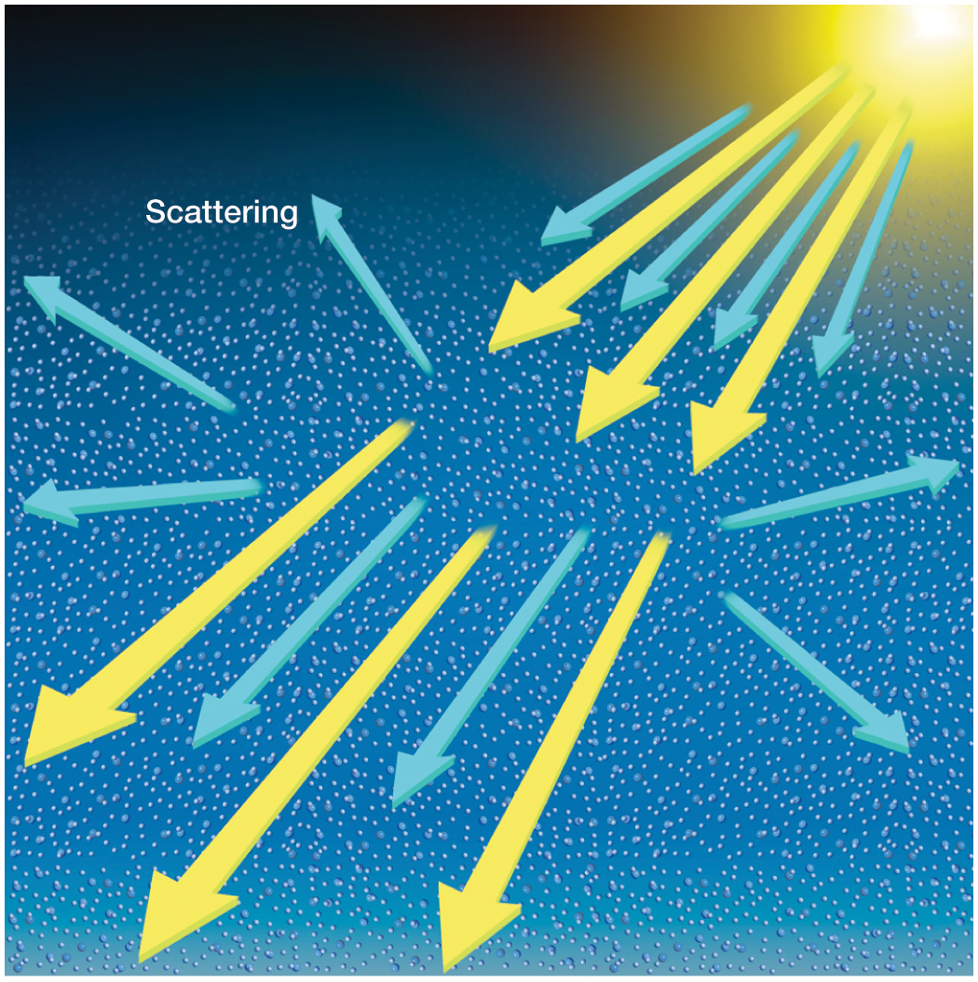
Gas molecules and particulate matter deflect light waves and redirect.
Notes:
Causes a change in direction of the light wave but not a change in wavelength. Some are backscattered into space and lost to Earth. Some waves continue through the atmosphere in altered but random directions. Eventually striking the surface as diffuse radiation. Amount of scattering depends on wavelength of light as well as size, shape, and composition of the gas molecule doing the scattering. In general shorter wavelengths are more readily scattered than longer wavelengths. Sky is blue because of short wavelenth and thus scattered all over the sky. Red and orange pass through. When the atmosphere is pollluted and has larger particles all wavelenths of light are equally scattered. Leaving the sky looking gray.
Sunset the light has to travel farther. (low in the sky) and all the blue has been scattered away leaving only red and orange.

Slide 6
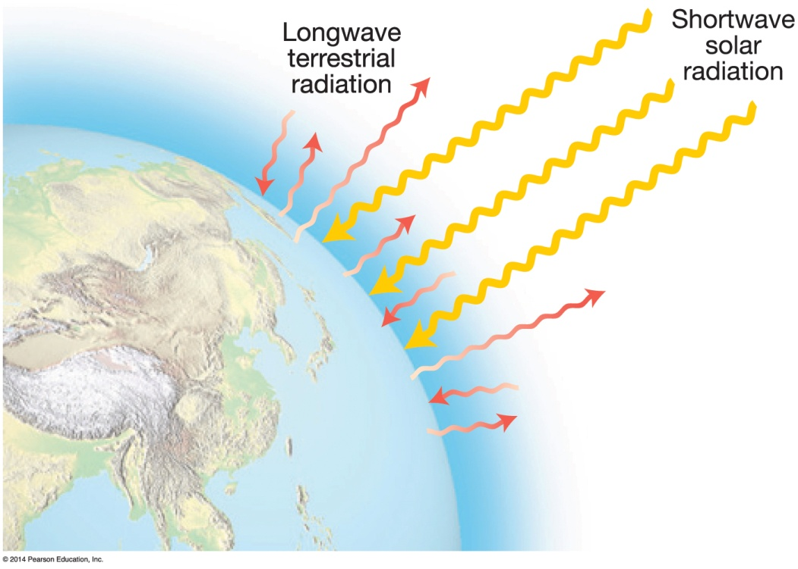
Basic Heating and Cooling Processes in the Atmosphere
Greenhouse Effect
Some atmospheric gases transmit shortwave radiation, but not Earth’s longwave radiation
Earth radiation held in by atmosphere
Atmospheric blanket

Slide 7
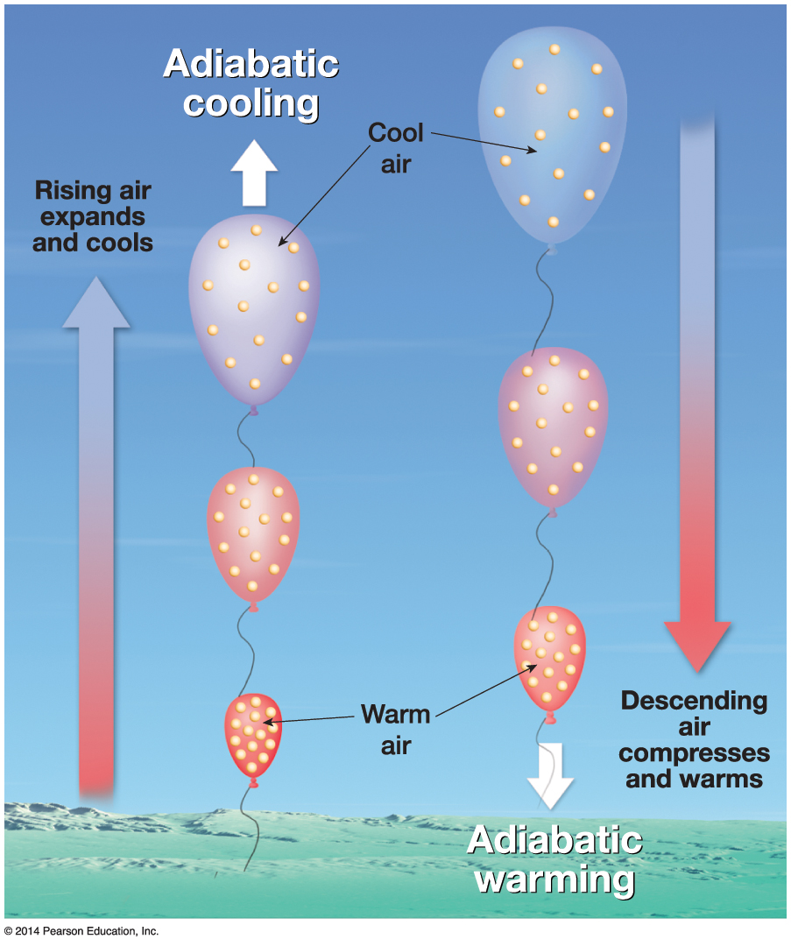
Basic Heating and Cooling Processes in the Atmosphere
Adiabatic cooling
Air rises and expands, molecular collisions decrease, so temperature decreases
Adiabatic warming
Air sinks and compresses, collisions increase so temperatures increase
Latent heat
Heat released or absorbed during a phase change of water.
“Latent” since heat is not felt

Slide 8
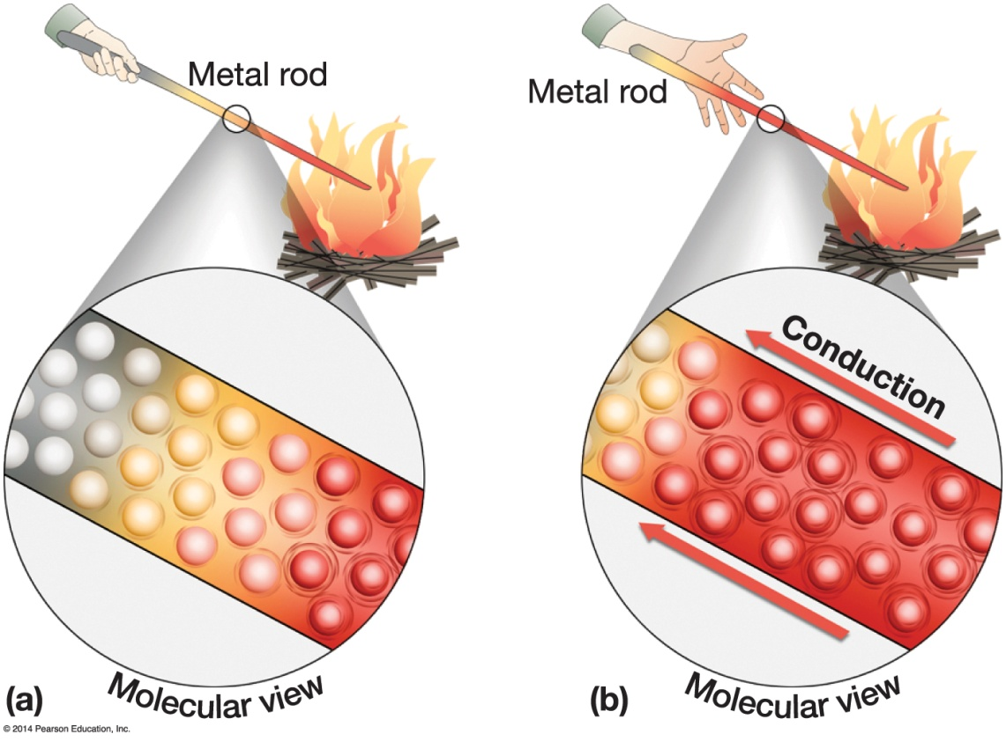
Basic Heating and Cooling Processes in the Atmosphere
Other heating types
Conduction
Transfer of heat energy across a medium
Air is a poor conductor

Slide 9
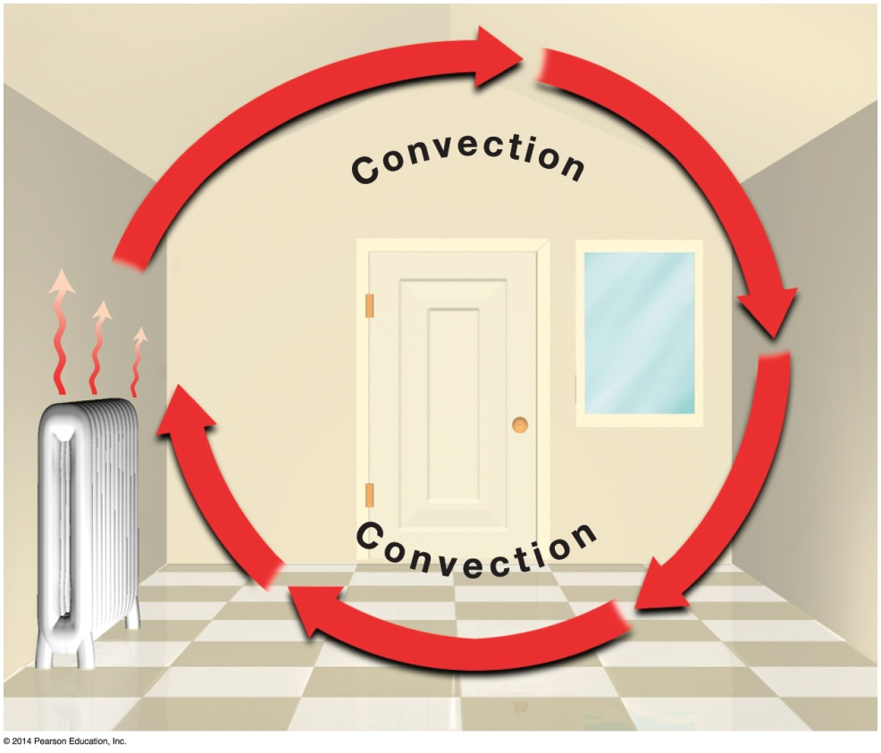
Basic Heating and Cooling Processes in the Atmosphere
Convection
Heat transfer by vertical circulation
Molecules move in tandem (blobs of air)
Convection cell
Advection
Horizontal transfer of heat in a moving fluid

Slide 10
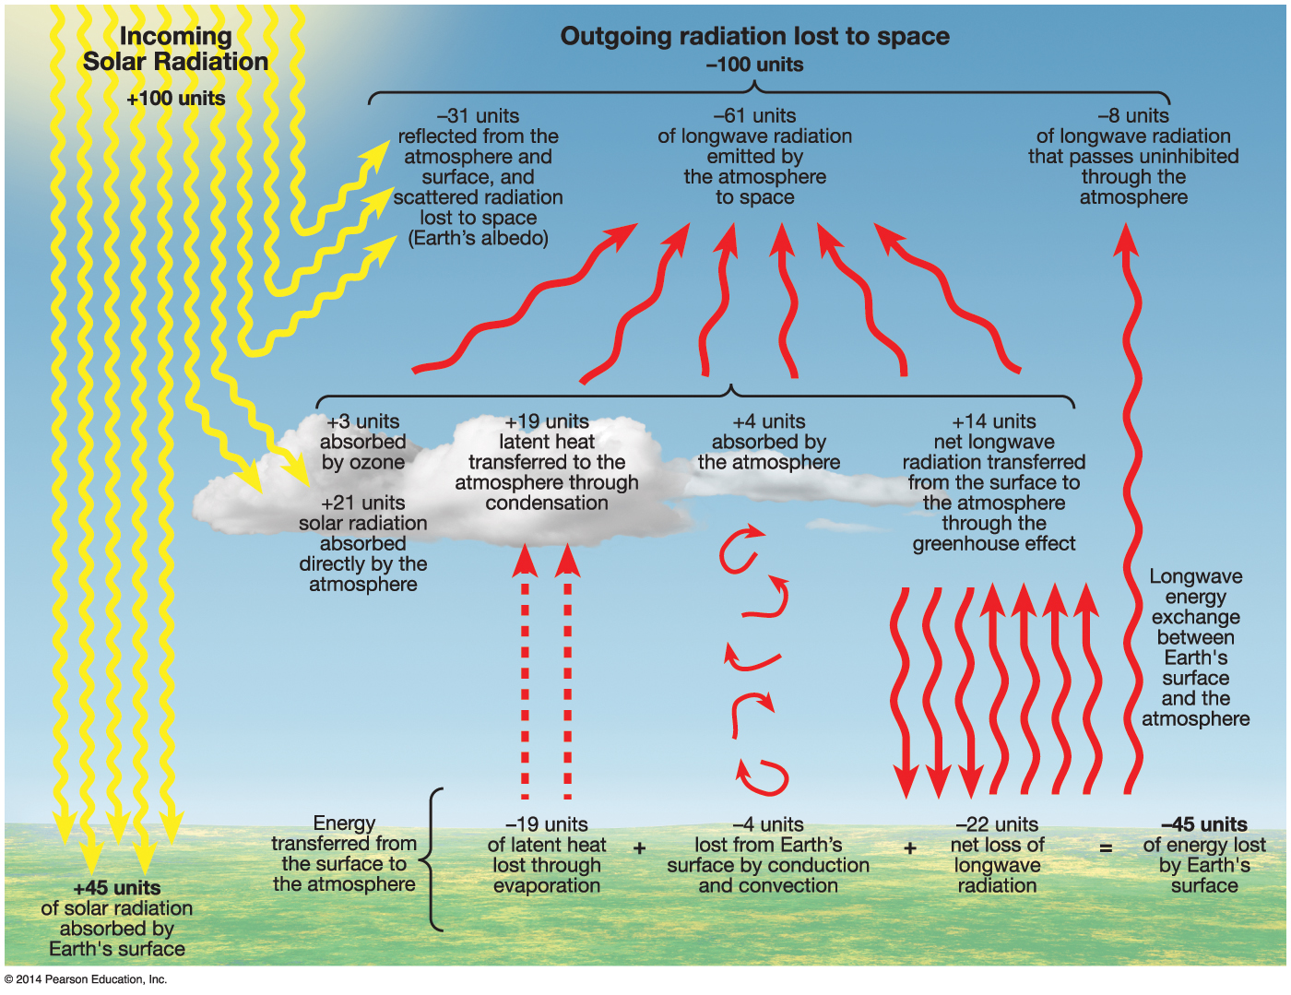
Earth’s Solar Radiation Budget
Earth’s radiation budget (animation in book-page 89)

Slide 11

Mechanisms of Global Energy Transfer
Need heat transfer to prevent constant warming at tropics and cooling at poles
Storms assist in heat transfer to a lesser degree than the atmosphere and oceans

Slide 12
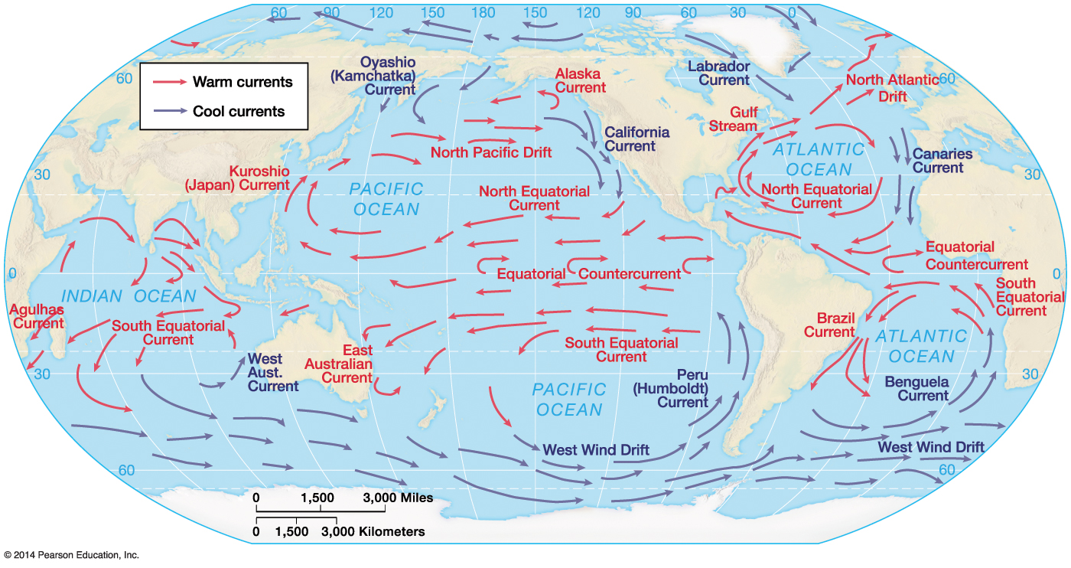

Mechanisms of Global Energy Transfer
Atmospheric circulation
General circulation, outlined in Chapter 5
Oceanic circulation (animation page 95)
Respond to average wind conditions over long time scales
Subtropical gyres

Slide 13
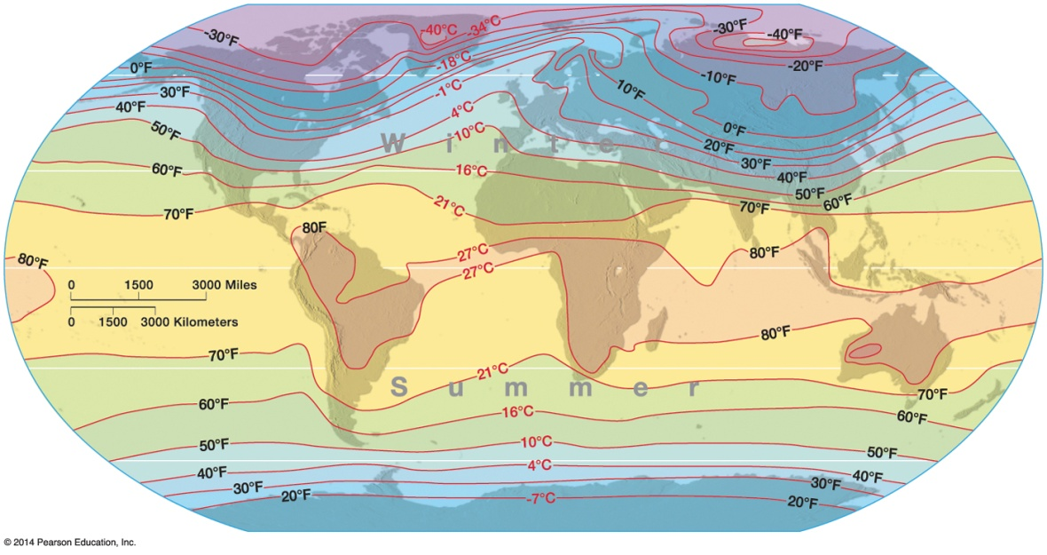
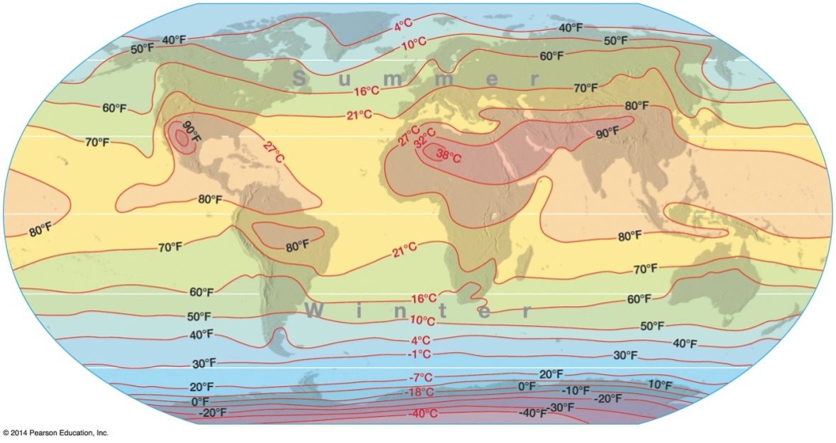

Global Temperature Patterns
Primary controls on global temperature
Altitude
Latitude
Land–water contrasts
Ocean currents
Atmospheric circulation

Slide 14
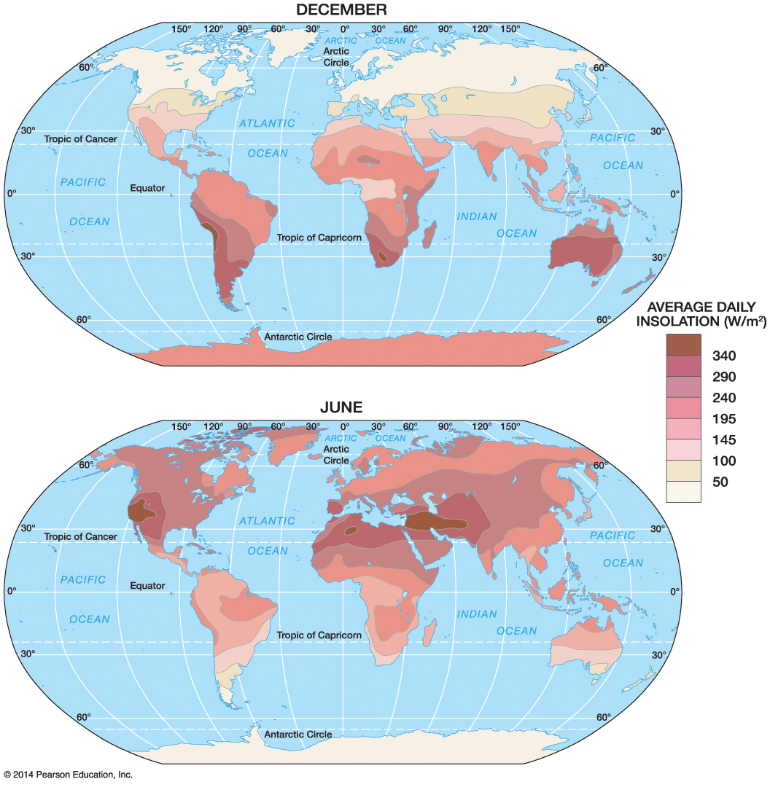

Variations in Insolation by Latitude and Season
Seasonal Variations in Insolation

Slide 15
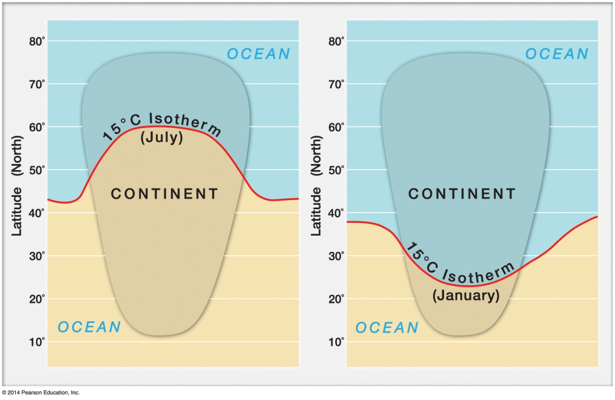

Global Temperature Patterns
Seasonal patterns
Latitudinal shift in isotherms from one season to another
More pronounced over continents than water and over high latitudes than low latitudes

Slide 16
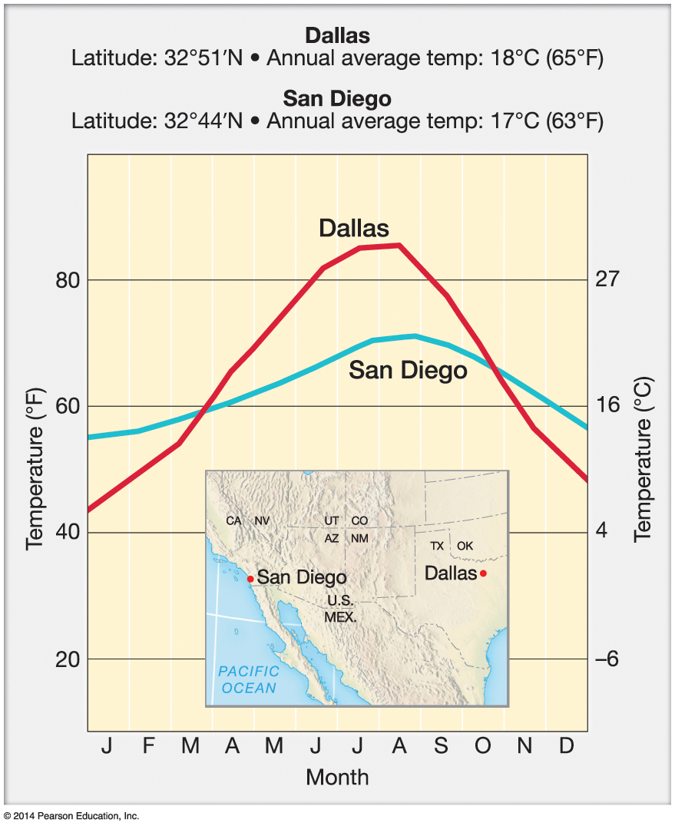

Land and Water Contrasts
Differences in climate due to land–water contrasts

Slide 17
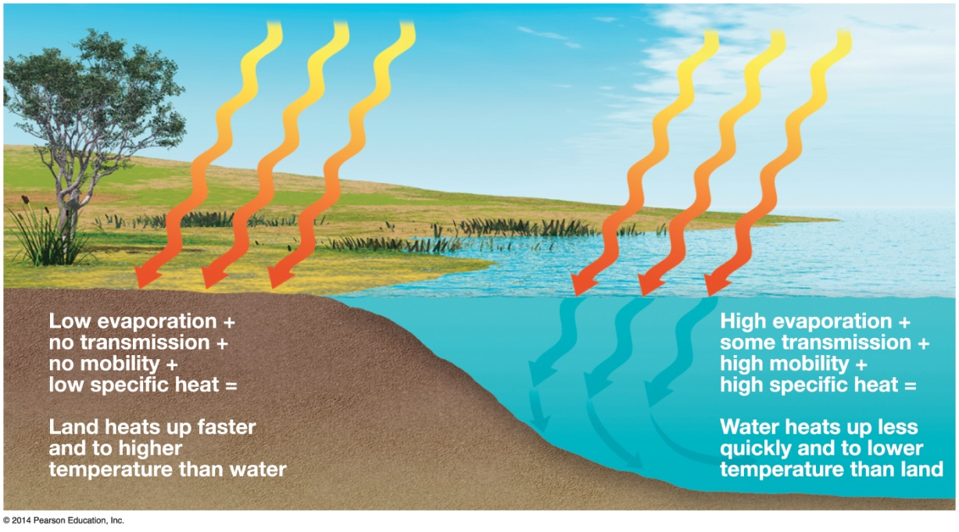

Land and Water Contrasts
Land heats and cools more rapidly than water due to the following:
Specific heat
Transmission
Mobility
Evaporative cooling

Slide 18
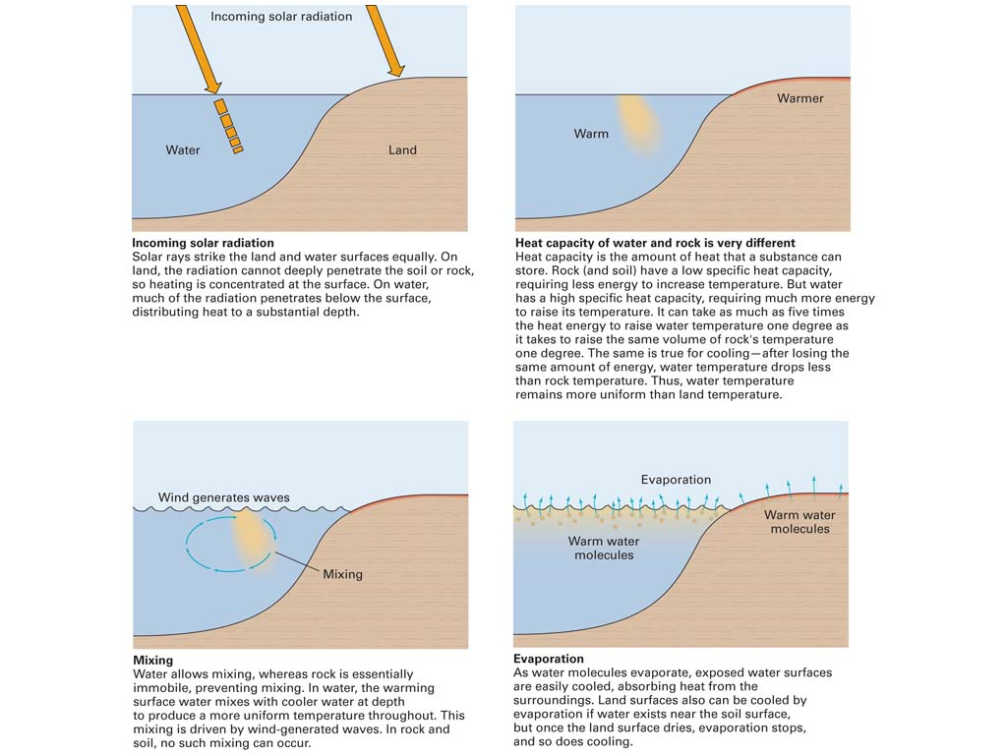

Daily and Annual Cycles of Air Temperature
Specific heat
Transmission
Mobility
Notes:
Land and Water Contrasts
Inland climates have more temperature extremes than coastal climates:
1. Solar rays heat land surface, but are distributed deeper in water
2. Water has higher heat capacity than rock and soil
3. Water mixes
4. Water evaporates, removing latent heat

Slide 19
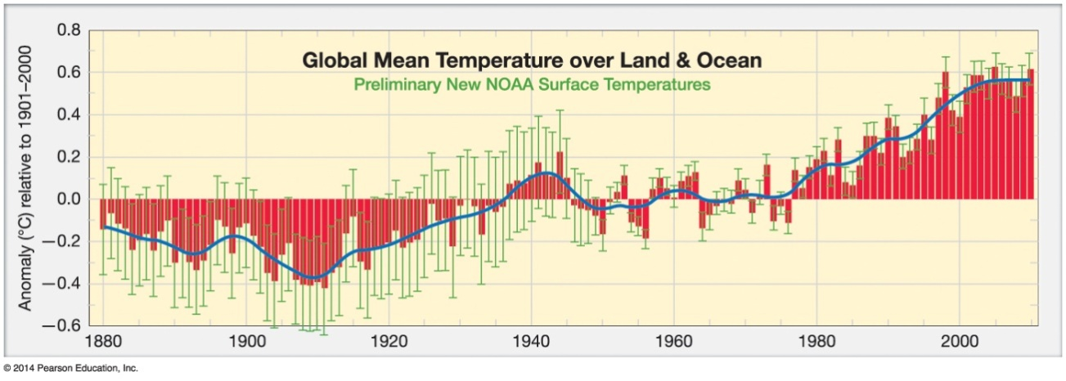

Climate Change and “Global Warming”
Temperatures on average have risen by 0.7°C in the last century, the fastest within the last 1000 years

